Slide 1


Gate Bias and Geometry Dependence of Total-Ionizing-Dose Effects in InGaAs Quantum-Well MOSFETs
Kai Niª, Enxia Zhangª, Ronald D. Schrimpfª,
Daniel M. Fleetwoodª, Robert A. Reedª, Michael L. Allesª,
Jianqiang Lin^{b}, and Jesus del Alamo^{b}
Department of Electrical Engineering and Computer Science, Vanderbilt University, Nashville, TN 37235 USA
Microsystems Technology Laboratories, Massachusetts Institute of Technology, Cambridge, MA 0239 USA
This work was supported by the Defense Threat Reduction Agency through its fundamental research program

Slide 2
Outline
Introduction
  III-V MOSFETs
  TID overview
Experimental Details
Gate bias dependence study
  V_{G} = +1.0 V
  V_{G} = -1.0 V
  Mechanism
Geometry dependence study
  Mechanism
Conclusion

Slide 3
Introduction
III-V MOSFETs
  High carrier mobility and injection velocity^{[1]}
  Next generation nMOSFET
Reliability issues
  High density of interface and border traps^{[2]}
  Need combined stress and irradiation experiment to study TID effect
[1] J. A. del Alamo, “Nanometre-scale electronics with III-V compound semiconductors,” Nature, vol. 479, no. 7373, pp. 317-323, Nov. 2011.
[2] S. Deora, et al., "Positive bias instability and recovery in InGaAs channel nMOSFETs", IEEE Trans. Device Mater. Rel., vol. 13, no. 4, pp. 507-514, 2013.

Slide 4
TID Overview
Previous work
  Based on thick Al₂O₃, 5 nm-8 nm^{[3][4]}
  No combined stress and irradiation measurement
[3] X. Sun, et al., “Total Ionizing Dose Radiation Effects in Al₂O₃-Gated Ultra-Thin Body In_{0.7}Ga_{0.3}As MOSFETs,” IEEE Trans. Nucl. Sci., vol. 60, no. 1, pp. 402-407, 2013.
[4] S. Ren, et al., "Total ionizing dose effects in extremely scaled ultra-thin channel nanowire gate-all-around InGaAs MOSFETs," IEEE Trans. Nucl. Sci., vol. 62, no. 6, pp. 2888-2893, Dec. 2015.

Slide 5
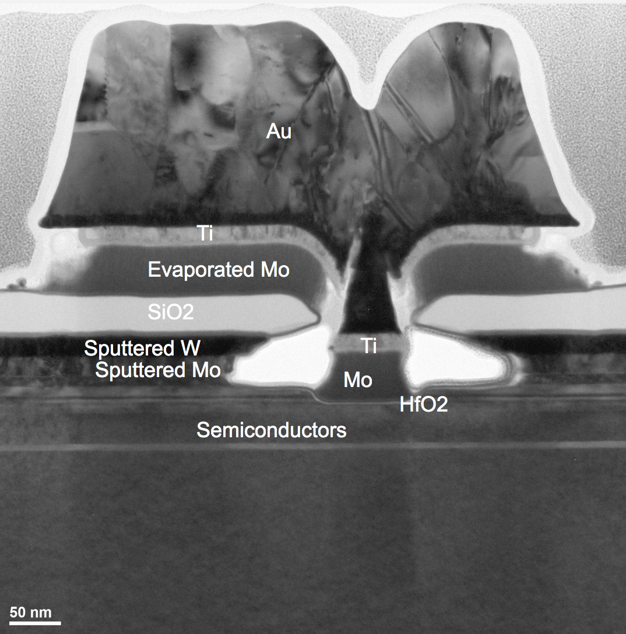
Experimental Details
Device under test
  Gate dielectric: 2.5 nm HfO₂, capacitance equivalent thickness=1.7 nm
  Mesa isolation (no isolation oxide)
  Quantum-well channel confines both electrons and holes
X-ray irradiation
  31.5 krad(SiO₂)/min
  Bias during irradiation V_{G}= ±1.0 V, V_{D}=V_{S}=0 V

Slide 6
Gate Bias Dependence
V_{G} = +1.0 V, E_{ox} = +0.8 MV/cm
  Positive V_{TH} shift, net electron trapping due to PBTI
  I_{ON} decreases 26 %, I_{OFF} increases 6%, more scattering
V_{G} = -1.0 V, E_{ox} = -0.8 MV/cm
  Negative V_{TH} shift, net hole trapping
  I_{ON} decreases 4 %, I_{OFF} increases 2X

Slide 7
Gate Bias Dependence
Subthreshold swing and transconductance
  SS and g_{m} degradation at V_{G}=-1.0 V is less than half at V_{G}=+1.0 V
  SS degradation correlates well with g_{m} degradation
    Interface traps and border traps are generated
    Electrons/holes detrap during annealing
V_{G} = +1.0 V
V_{G} = -1.0 V

Slide 8
Gate Bias Dependence
Stress induced 𝚫V_{TH} is measured and subtracted from biased TID response
  V_{G}=+1.0 V, PBTI, net electron trapping
  V_{G}=-1.0 V, NBTI, net hole trapping
  After subtraction, hole trapping in both V_{G}=±1.0 V
V_{G} = +1.0 V
V_{G} = -1.0 V
Pure TID

Slide 9
Gate Bias Dependence
More hole trapping at V_{G}=+1.0 V than V_{G}=-1.0 V
  Hole centroid closer to HfO₂/InGaAs interface at V_{G}=+1.0 V than V_{G}=-1.0 V
  𝚫V_{TH} is higher at V_{G}=+1.0 V than V_{G}=-1.0 V
V_{G} = +1.0 V
V_{G} = -1.0 V

Slide 10
Geometry Dependence
Different gate lengths
  The pure TID induced 𝚫V_{TH} increases with the transistor size
  More hole trapping for large size transistor
V_{G} = +1.0 V
V_{G} = -1.0 V

Slide 11
Geometry Dependence
Gate oxide electric field
  Electric field difference less than 1% for different gate lengths
Isolation structure
  Mesa isolation, no isolation oxide
Oxide quality
  Strain in HfO₂ varies with gate length
  Evaluated for SiO₂/Si devices^{[5]}
    Hole trapping decreases if interfacial
    Si tensile stress decreases
    Smaller size transistor introduces more compressive stress
  More tensile stress in InGaAs may cause increased hole trapping for larger size transistor
MESA isolation: etch away
[5]. V. Zekeriya, and T. P. Ma, “Dependence of X-ray generation of interface traps on gate metal induced interfacial stress in MOS structures,” IEEE Tran. Nucl. Sci. vol. ns-31, no. 6, pp. 1261-1266, Dec. 1984

Slide 12
Conclusion
Combined stress and Irradiation
  At positive gate biased irradiation, PBTI induced electron trapping dominates over TID induced hole trapping
  At negative gate biased irradiation, NBTI induced hole trapping adds together with TID induced hole trapping
  More TID induced hole trapping under positive gate bias than negative gate bias.
Geometry dependence
  Larger devices have more TID induced hole trapping
  Strain likely causes such geometry dependence

Slide 13


